Slide 1
Filariasis
Prof Chrishantha Abeysena
Faculty of Medicine
University of Kelaniya
Ragama

Slide 2
Lymphatic Filariasis: The Disease
A parasitic disease caused by threadlike worms living in the human lymphatic system
Transmitted by mosquitoes
Endemic in 83 countries
1.2 billion people at risk
  More than 120 million people infected
  More than 25 million men suffer from genital disease
  More than 15 million people suffer from lymphoedema or elephantiasis of the leg

Slide 3
Lymphatic Filariasis and Children
Infection acquired in childhood
Often with as many as 1/3 of children infected before age 5
Because of the long latency period of the disease, visible symptoms usually appear in puberty

Slide 4
A Disease of Poverty
LF occurs primarily in poor communities
The disease exacerbates poverty by physically
incapacitating people, thus affecting their livelihood
Lost productivity caused by LF disease costs billions of dollars across the world each year
Medical treatment for the disease imposes a tremendous burden on individuals and health care systems

Slide 5
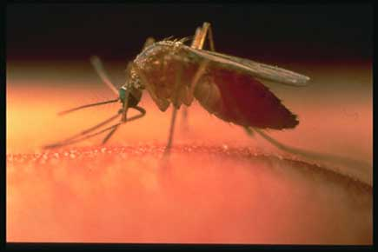
Culex quinquefasciatus

Slide 6
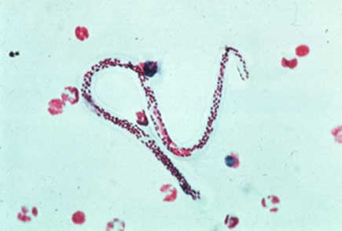
W. bancrofty – microfilaria

Slide 7
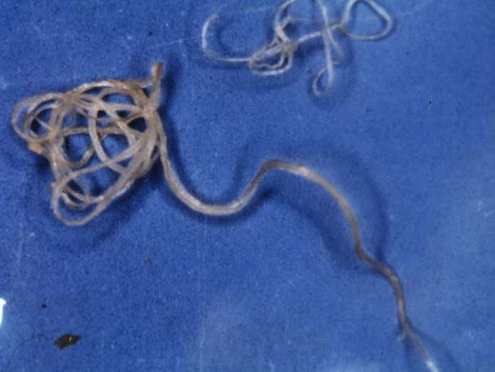
W. bancrofty – adult worm

Slide 8
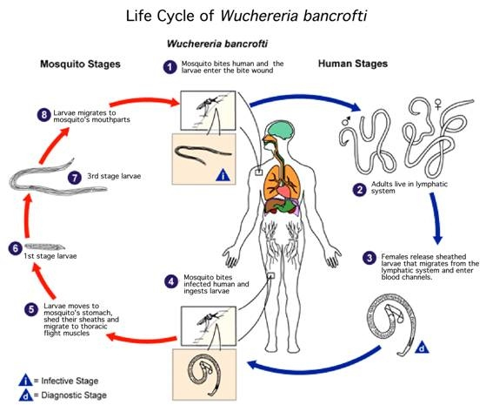

Slide 9
Life cycle
Three larval stages in the mosquito L₁ L₂ L₃
The mosquito is said to be infective when it has L₃
The duration of mosquito cycle is between 10 – 14 days
Incubation period: 8 -16 months

Slide 10
Clinical manifestations
1. Asymptomatic Amicrofilaremia
2. Asymptomatic Microfilaria
3. Acute manifestations
4. Chronic manifestations

Slide 11
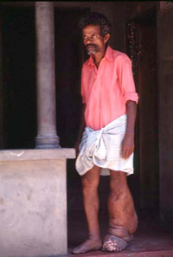
Elephantiasis

Slide 12
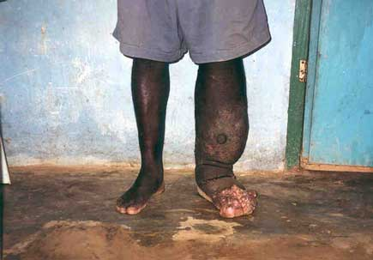
Elephantiasis

Slide 13
Elephantiasis
A major cause of permanent disability and disfigurement
Adult worms damage the lymphatic system, causing fluid to collect and cause swelling
Patients are physically incapacitated

Slide 14
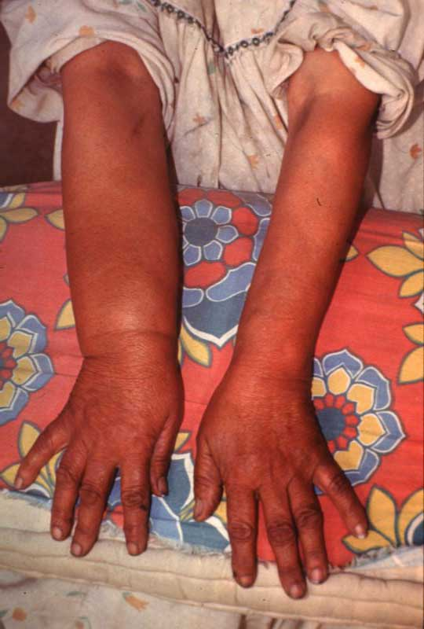

Slide 15
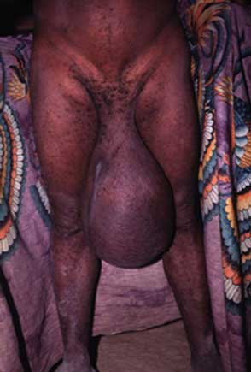

Slide 16
Diagnosis
1. Clinically
2. Night Blood Filming (NBF)
3. Filaria Antibody Test (FAT)
  Not recommended
4. Filaria Antigen Test
  Highly sensitive
  Highly specific
  Simple to perform

Slide 17
Epidemiology
In Sri Lanka, the highest endemicity is found in the Western, Southern and the North-Western Provinces
Covering an area of approximately 16,482 sq km in extent with a population of 10 million at risk
It is mainly seen in these areas due to rapid and unplanned urbanization
The migration of people to and from the endemic zone has resulted in spreading the disease to other areas as well

Slide 18
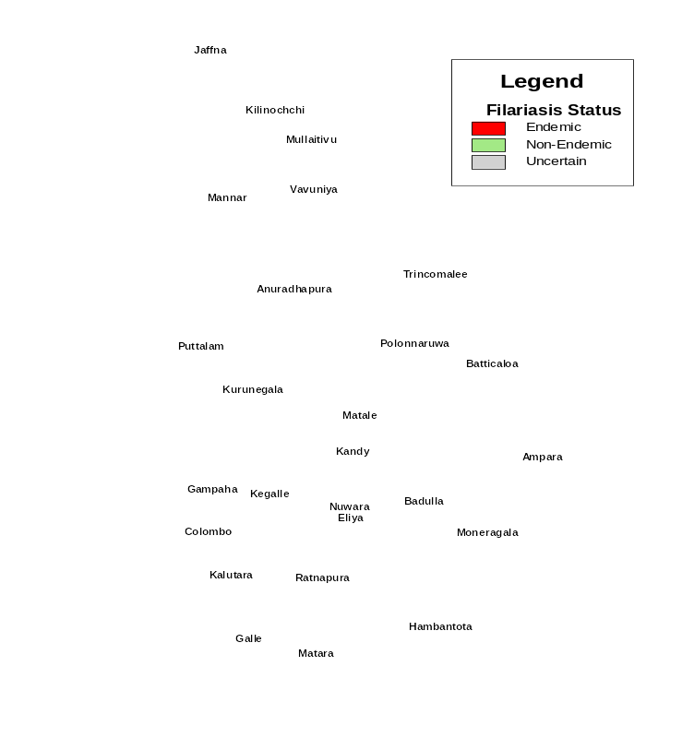
Endemicity of LF in Sri Lanka
Endemic in three provinces ( 8 districts)
Southern (Galle, Matara, Hambantota)
Western (Colombo, Gampaha, Kalutara)
North Western (Puttalam, Kurunegala)
9.8 million people are at risk. (Half
the population of the country)
Low level transmission
in most of the non-endemic
areas

Slide 19
History of LF in Sri Lanka
Traced back to 4th century B.C.
First all island survey in 1936 - 1939 by Dassanayake
MF rate was in the range of 20-24%
Inauguration of Anti Filariasis Campaign in 1947
MF rate brought down to 5-6%
It has remained static at a lower level of transmission
Since 1949 more cases of Bancroftian filariasis have
been recorded

Slide 20
History of LF in Sri Lanka…
From 1947 to 1999 - Mass screening with selective
treatment of patients with the disease and positive MF
1999 - 2001 Mass Drug Administration (MDA) with DEC alone (68% coverage)
2002 – 2006 MDA with DEC/Albendazole (> 80%
coverage in all endemic districts – Implementation
Units)
Since 2008 – Post MDA Surveillance

Slide 21
Goal & Objectives
Goal – To eliminate lymphatic filariasis as a public health problem, over the next 10 years.
Objectives
To stop the spread of filarial infection (i.e interrupt transmission).
To reduce the vector density in the endemic areas.
To alleviate the suffering and disability of affected individuals (i.e control morbidity)

Slide 22
Performance
Sri Lanka will receive the Certification on Elimination of Lymphatic Filariasis on July 2016 from WHO as Sri Lanka has successfully brought down the microfilaria rate of less than 1%.

Slide 23
Strategies
Parasite control
Vector control
Entomological investigations
Mass drug therapy

Slide 24
Parasite control
Parasite control through screening the population annually by night blood screening and treating the positives with Diethyl Carbamazine Citrate (DEC), until they are free of infection
Early detection of mf carriers in the community & then treatment & follow up before developing symptoms
Conduct NBF centers in the MOH offices within the endemic belt

Slide 25
Parasite control
DEC, 3 tablets twice daily for 2 weeks
For one month no DEC
Repeat the same dose for another 2 weeks
Wait for another one month without DEC
NBF is taken
If it is positive – re-cycle the dose of DEC
If it is negative – follow up at 6 months intervals for 2 years

Slide 26
DEC – adverse effects
Fever Head ache
Dizziness Drowsiness
Anorexia Nausea, Vomiting
Urticaria Bronchospasm
Exacerbation of symptoms – lymphangitis,
lympoedema
Action – Filaricidal; kill adult worm as well as mf.
Not all adult worms are killed by a single dose of DEC

Slide 27
Parasite control
Filaria clinics
Functioning in the endemic belt to treat patient with clinical manifestations

Slide 28
Vector Control
Larval control
By elimination
Temporary breeding sites consisting of empty tins, pots, spent coconuts etc. are eliminated after soliciting the co-operation of householders
Treating the breeding places with larvicides Baytex or Fenthion in mixed concentration
The permanent breeding places that could not be eliminated have to be treated with larvicide on weekly cycle

Slide 29
Entomological Investigations
The Entomological Unit, by collecting indoor resting Culex quinquefasciatus mosquitoes
Dissected to ascertain the infection and infective rates, which indicate the disease status in the community
No. of mosquitoes infected with
Infection rate = all stages of filaria lava (L1L2L3)
Total number of mosquitoes dissected
Infective rate = No. of mosquitoes infected with L3 stage
Total no. of mosquitoes dissected

Slide 30
Single dose mass treatment programme
Commenced in selected areas of Sri Lanka during 1997
A national programme was launched in October 1999
In 2001 Dec. Albendazole combination was used in Colombo District for the first time while all other 7 districts were given DEC only.
Adults were given 300 mg as a single dose and Albendazole 400 mg irrespective of the age

Slide 31
Single dose mass treatment programme
Children 2 to 12 year of age were given 150 mg of DEC and Albendazole 400 mg irrespective of the age
Pregnant and lactating women, seriously sick persons were excluded
It is necessary to reach coverage of 80 per cent to achieve the desired objectives
According to the reported figures 86% coverage have been achieved in 2002

Slide 32
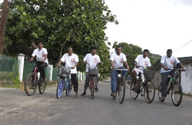

Slide 33
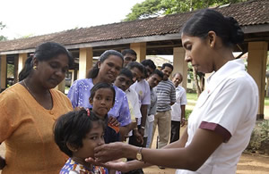

Slide 34
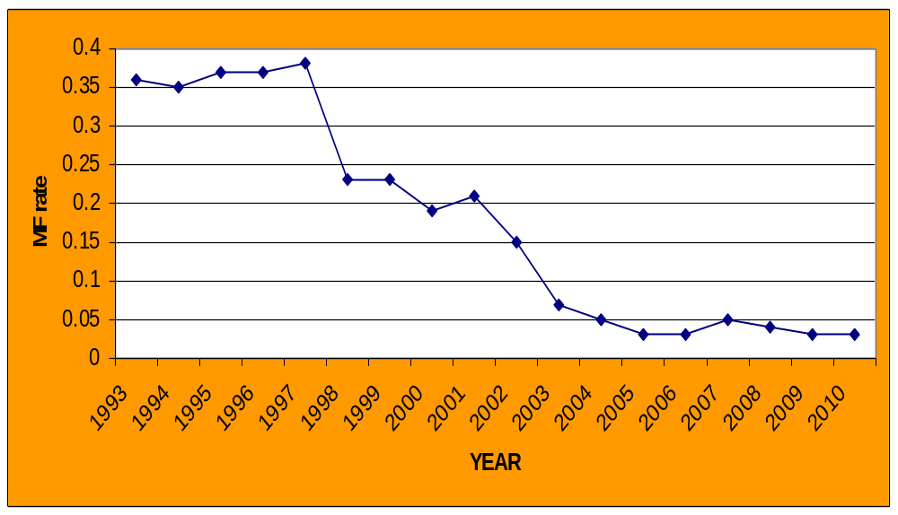
Microfilaria Rates in Sri Lanka
1993 -2010
0.36
0.19
DEC + Alb in Colombo
2001
DEC + Alb Endemic Areas 2002-2006
0.03
SDS

Slide 35
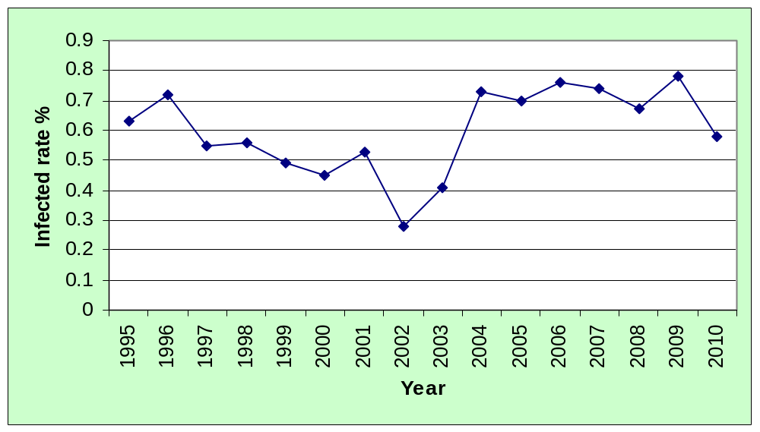
Infected Mosquito Rate 1995 - 2010
0.63
0.58
0.28
SDS

Slide 36
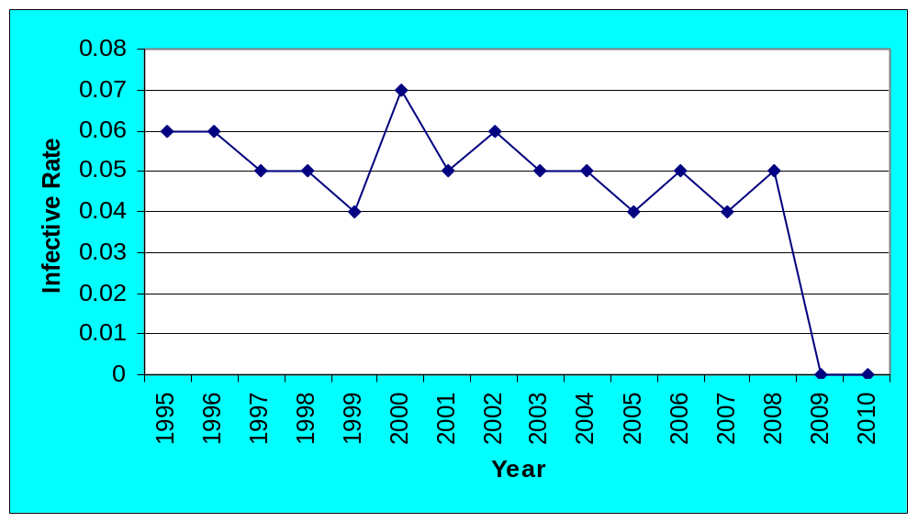
Infective Mosquito Rate 1995 - 2010
0.06
0.06
0.00
SDS

Slide 37
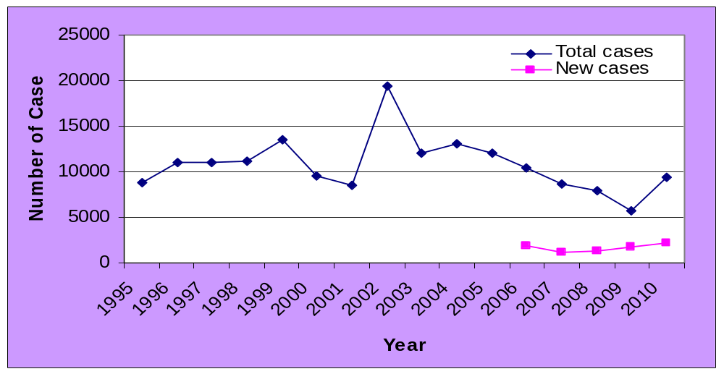
Clinic visits to Anti Filariasis Clinics 1995 - 2010
19439
8773
9455
1856
2210
SDS

Slide 38
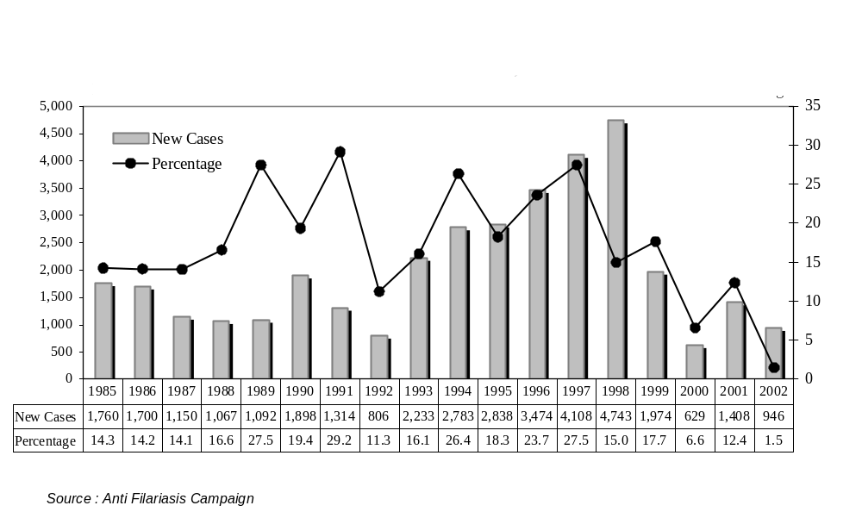

Slide 39
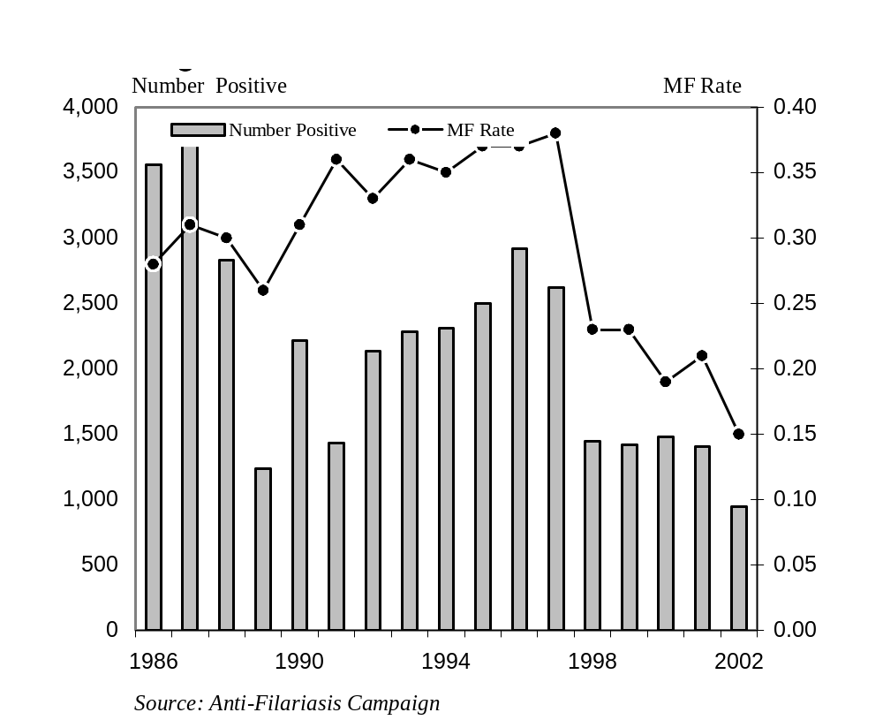

Slide 40
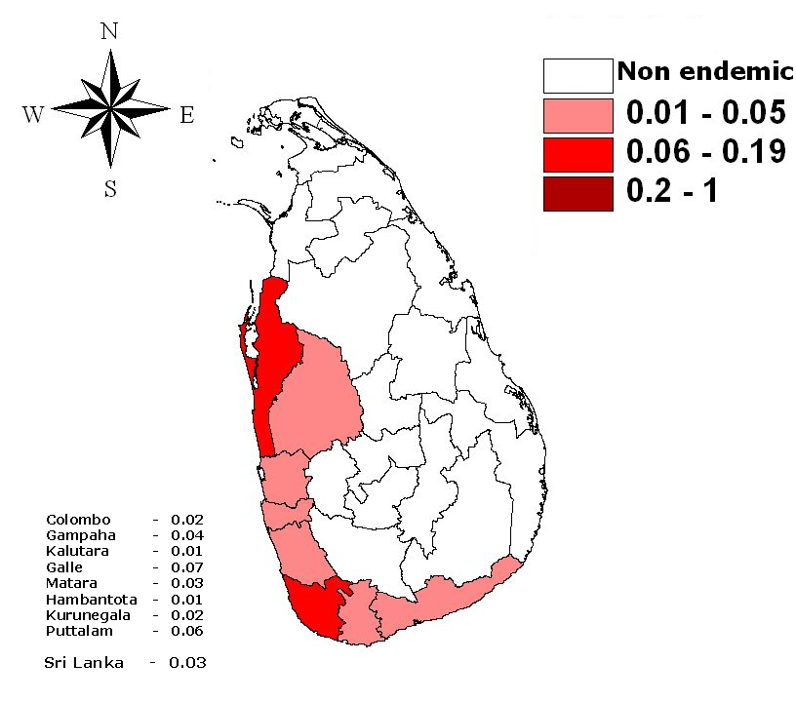
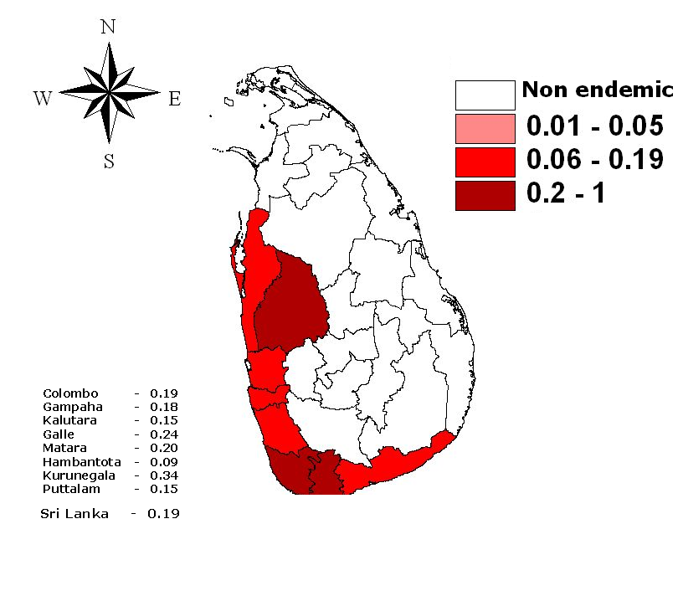
Microfilaria Rate in Endemic Districts
Pre & Post MDA
2000
2009

Slide 41
Performance
In Sri Lanka, mf rate was below 1% over the past 15-20 years and
With the MDA, mf rate has declined drastically to the current mf rate of 0.03%.
This is very much below the WHO elimination target of <1%.

Slide 42
Performance
Post MDA surveillances including Transmission Assessment Surveys (TASs) conducted among grade 1 and 2 school children in endemic districts in 2008 and special surveys conducted in 2009 and 2010, further confirmed the elimination status.
WHO declared in April, 2011 that Sri Lanka is one of the first countries in the South-East Asia Region qualified to initiate the verification process by WHO for certification of elimination of lymphatic Filariasis.

Slide 43
Functions of the Provincial components
Parasitological investigations of mf carries in the community, treatment & follow up
Vector control & Entomological investigations in relation to the vector
Maintenance of treatment clinics
Maintenance of NBF centers in different MOH areas
Health education

Slide 44
Functions of the National component
Formulation of the national policy on filaria control
Monitoring & Evaluation of work carried out through the provincial component
Detection of new foci of disease in the area outside the endemic belt
Health education of the community at large to get satisfactory coverage
Training of all categories of staff engaged in the work
Provision of technical guidance to the provincial filaria control programs

Slide 45
Global elimination Strategy
Two approaches
1. Interrupt Transmission
2. Alleviate and prevent disability

Slide 46
Interrupt transmission
Annual treatment of entire populations at risk with medicines
  albendazole + diethylcarbamazine (DEC)
DEC-fortified salt
Must be treated for at least 5 years

Slide 47
Alleviate and prevent disability
Community-level care for those with disease
Lymphoedema management
Prevention of acute inflammatory episodes
Hydrocele repair

Slide 48
Lymphoedema management
Washing the affected parts twice daily with soap and clean, cool water, and drying carefully
Raising the affected limb at night
Exercising the limb regularly
Keeping the nails clean
Wearing comfortable shoes
Using medicated creams or antibiotics to treat small wounds or abrasions
Through these methods, even the worst case of elephantiasis can be improved over time

Slide 49
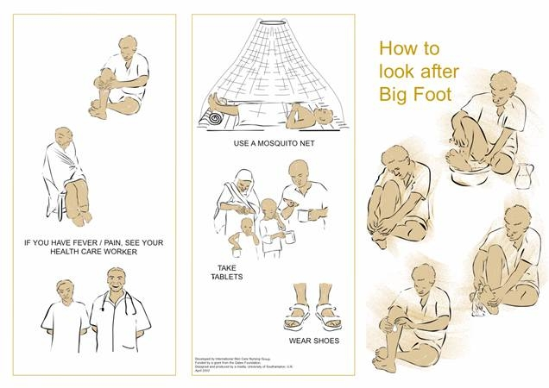

Slide 50
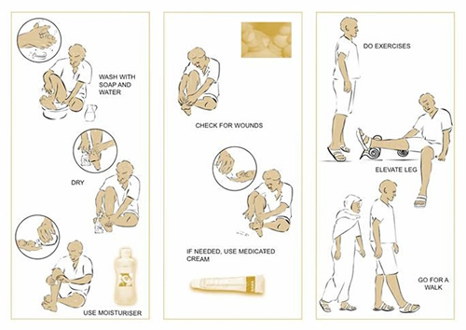

Slide 51
Patient Education and Counseling
Psychological counseling is also essential to support those patients with LF-induced disability who can suffer from acute shame, isolation, sexual dysfunction and intense chronic pain and suffering

